Slide 1

Support Vector Machine - Math
Presented by:
Elizer Ponio Jr.
Department of Computer Science
College of Computing and Information Technologies

Slide 2
Outline
Hard Margin SVM
Soft Margin SVM

Slide 3
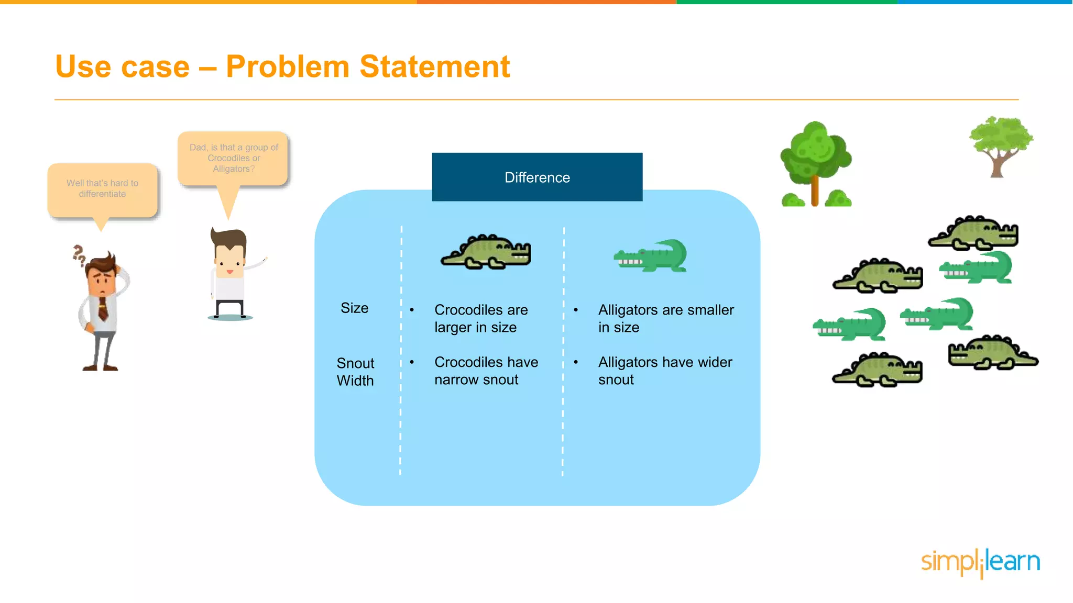
Hard Margin
When the data is linearly separable, and we do not want to have any misclassifications, we use SVM with a hard margin.
Snout Width
Size

Slide 4
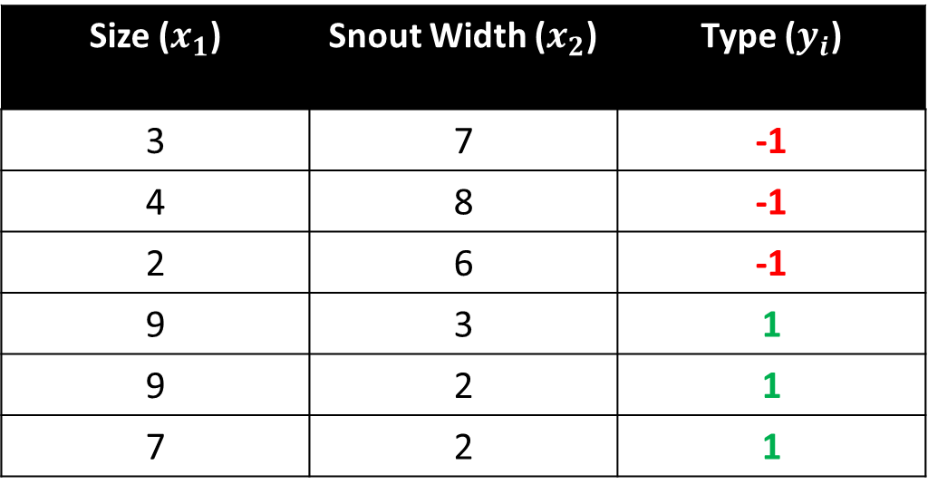
Crocodile and Alligator Example
Size ($x_{1}$) | Snout Width ($x_{2}$) | Type ($y_{i}$)
3 | 7 | -1
4 | 8 | -1
2 | 6 | -1
9 | 3 | 1
9 | 2 | 1
7 | 2 | 1

Slide 5
Snout Width
Size

Slide 6
-1
Snout Width
+1
Size

Slide 7



$\vec{w }$⋅ $\vec{x }$ - b = -1
Snout Width
$\vec{w }$⋅ $\vec{x }$ - b = +1
$\vec{w }$⋅ $\vec{x }$ - b = 0
Size

Slide 8


$\vec{w }$⋅ $\vec{x }$ - b = -1
Snout Width
$\vec{w }$⋅ $\vec{x }$ - b = +1
$\vec{w }$⋅ $\vec{x }$ - b = 0
$\vec{w_{1}}$ $\vec{x_{1}}$ + … + $\vec{w_{p}}$ $\vec{x_{p}}$ - b = 0
$$Hyperplane$$
Size

Slide 9

$$\vec{w }$$
Snout Width
Size

Slide 10
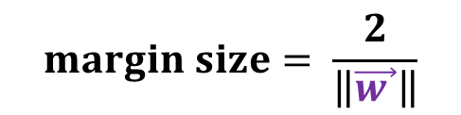
$$\vec{w }$$
Snout Width
$$margin size= \frac{2}{\left\|\vec{w }\right\|}$$
Size

Slide 11
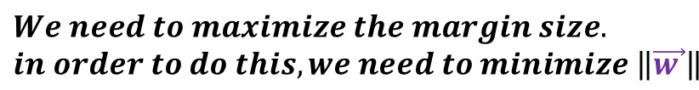
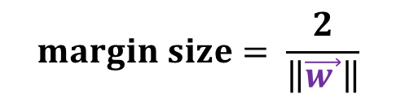

$$\vec{w }$$
Snout Width
$$margin size= \frac{2}{\left\|\vec{w }\right\|}$$
$$We need to maximize the margin size.$$
$$in order to do this, we need to minimize \left\|\vec{w }\right\|$$
Size

Slide 12
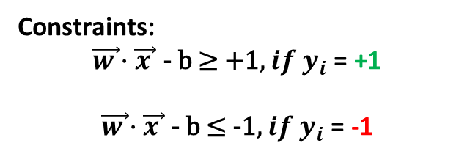
$$\vec{w }$$
Snout Width
$$margin size= \frac{2}{\left\|\vec{w }\right\|}$$
Constraints:
$$\vec{w }\text{⋅ }\vec{x }\text{ − }\text{b}\text{ ≥ +1, }{if y}_{i}\text{ = }\text{+1}$$
$$\vec{w }\text{⋅ }\vec{x }\text{ − }\text{b}\text{ ≤ −1, }if y_{i}\text{ = }\text{−1}$$
Size

Slide 13
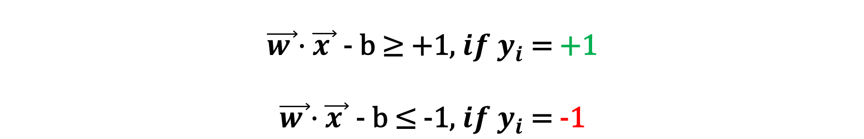
Hard Margin SVM Equation
$$\vec{w }\text{⋅ }\vec{x }\text{ − }\text{b}\text{ ≥ +1, }{if y}_{i}\text{ = }\text{+1}$$
$$\vec{w }\text{⋅ }\vec{x }\text{ − }\text{b}\text{ ≤ −1, }if y_{i}\text{ = }\text{−1}$$
These constraints state that each data point must lie on the correct side of the margin. These two conditions can be rewritten in a compact form
$$y_{i}\text{(}\vec{w}\text{ ⋅ } \vec{x_{i}}\text{ − }\text{b}\text{)} \text{≥ +1}$$

Slide 14

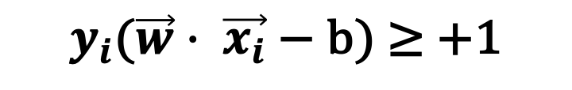
Hard Margin SVM Equation
$pick a w,b such that \left\|w\right\| is minimized$ while obeying the constraint
$$y_{i}\text{(}\vec{w}\text{ ⋅ } \vec{x_{i}}\text{ − }\text{b}\text{)} \text{≥ +1}$$
$$for all i=1, …, n$$

Slide 15

Outline
Hard Margin SVM
Soft Margin SVM

Slide 16
Soft Margin
When a linear boundary is not feasible, or we want to allow some misclassifications in the hope of achieving better generality, we can use SVM with a soft margin.
Snout Width
Size

Slide 17
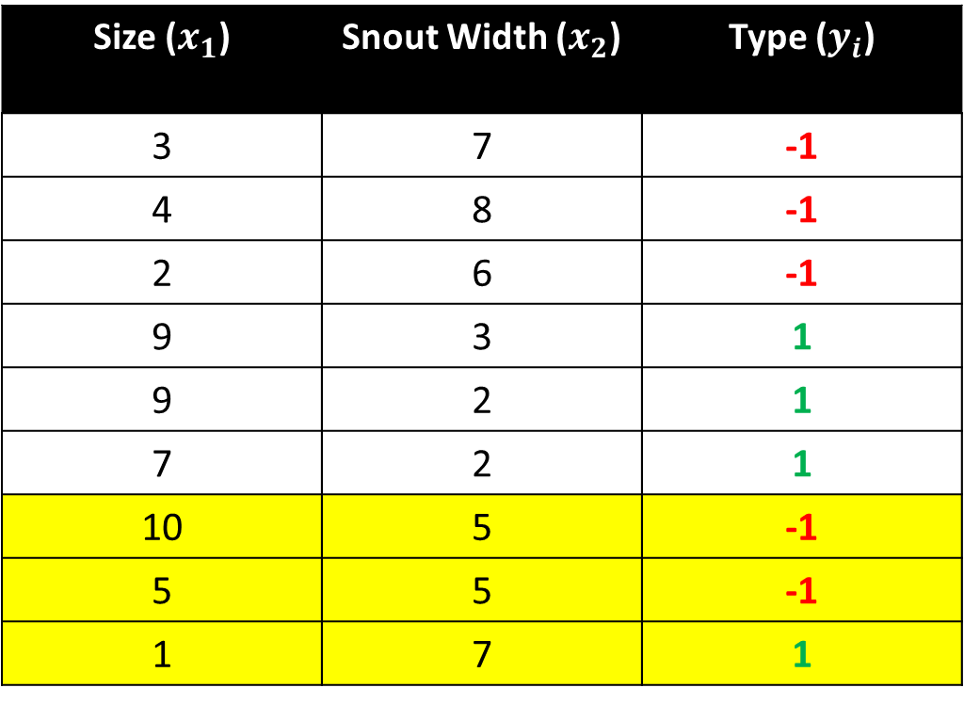
Crocodile and Alligator Example
Size ($x_{1}$) | Snout Width ($x_{2}$) | Type ($y_{i}$)
3 | 7 | -1
4 | 8 | -1
2 | 6 | -1
9 | 3 | 1
9 | 2 | 1
7 | 2 | 1
10 | 5 | -1
5 | 5 | -1
1 | 7 | 1

Slide 18




Snout Width
Size

Slide 19
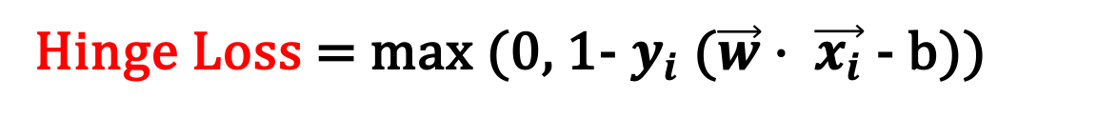
Loss Function
If we allow misclassifications to happen, we need to minimize the error and define a loss function. A loss function used for soft margin is the hinge loss.
Hinge Loss = max (0, 1- $y_{i}$ ($\vec{w}$ ⋅ $\vec{x_{i}}$ - b))

Slide 20



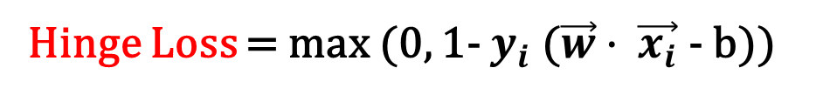
Loss Function
Hinge Loss = max (0, 1- $y_{i}$ ($\vec{w}$ ⋅ $\vec{x_{i}}$ - b))
Snout Width
max (0, 1 - 1( $>1$)) = 0
max (0, 1 + 1($<−1$)) = 0
max (0, 1 + 1($>1$)) = > 1
max (0, 1 + 1($Between 0 \& 1$)) = $Between 0 \& 1$
Size

Slide 21
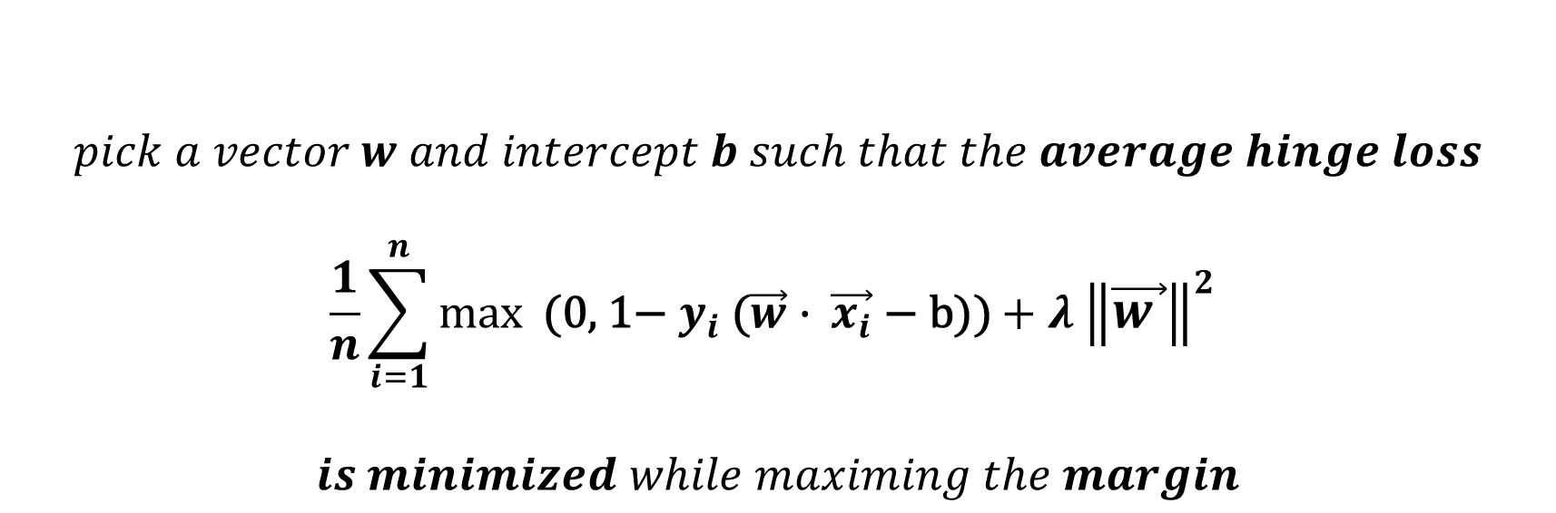
Soft Margin SVM Equation
$$pick a vector w and intercept b such that the average hinge loss$$
$$\frac{1}{n}\sum_{i=1}^{n}{max⁡\text{ (0, 1− }y_{i}\text{ (}\vec{w}\text{ ⋅ } \vec{x_{i}}\text{ − }\text{b}\text{))}}+λ {\left\|\vec{w }\right\|}^{2}$$
$$is minimized while maximing the margin$$
$Lambda (λ)$ is a positive parameter which determines the trade off between increasing the margin size and ensuring that $\vec{x_{i}}$ lie on the correct side of the margin.

